Slide 1


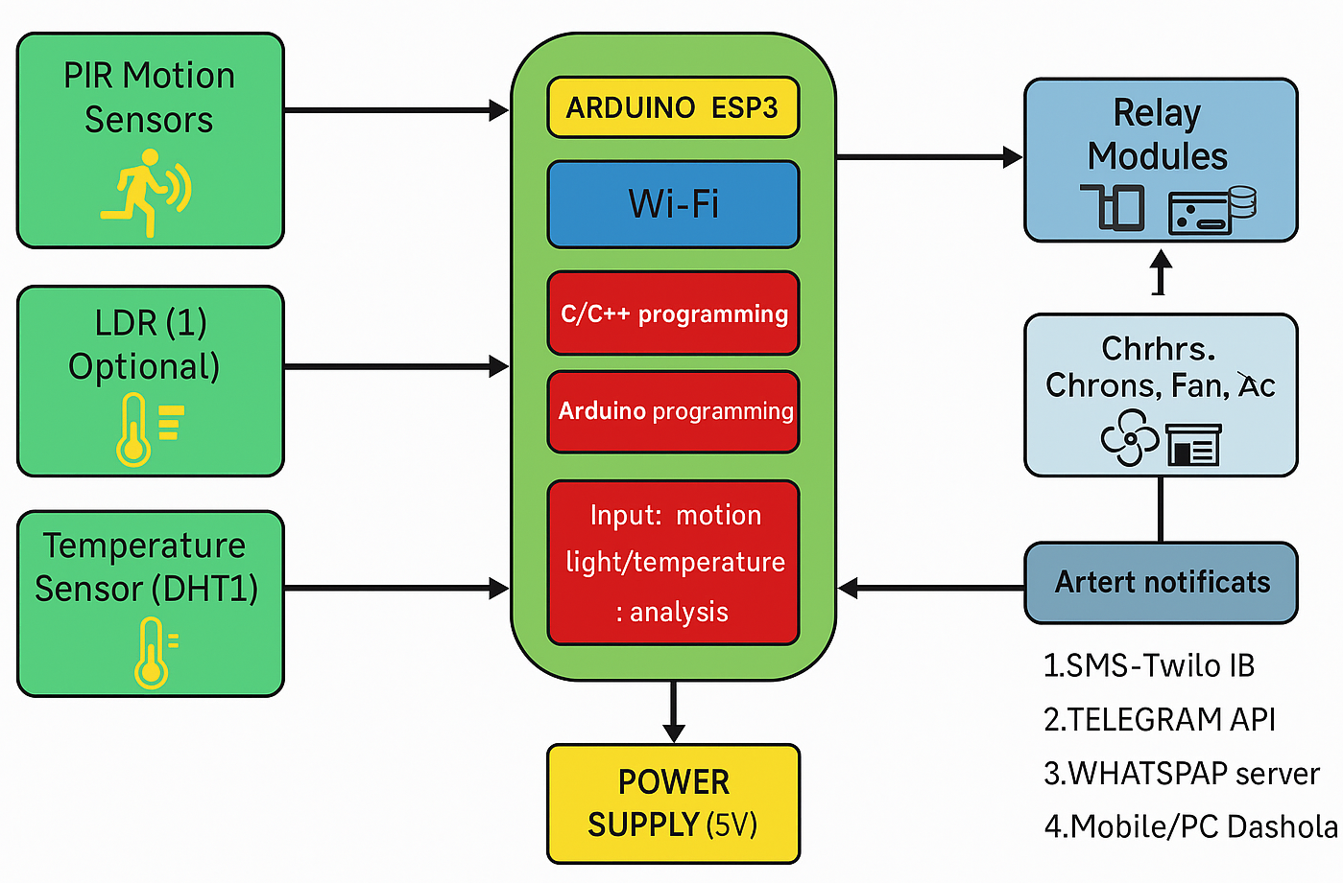
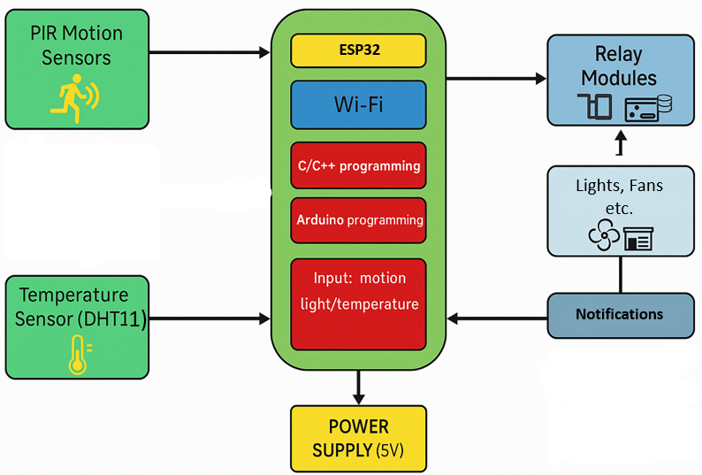
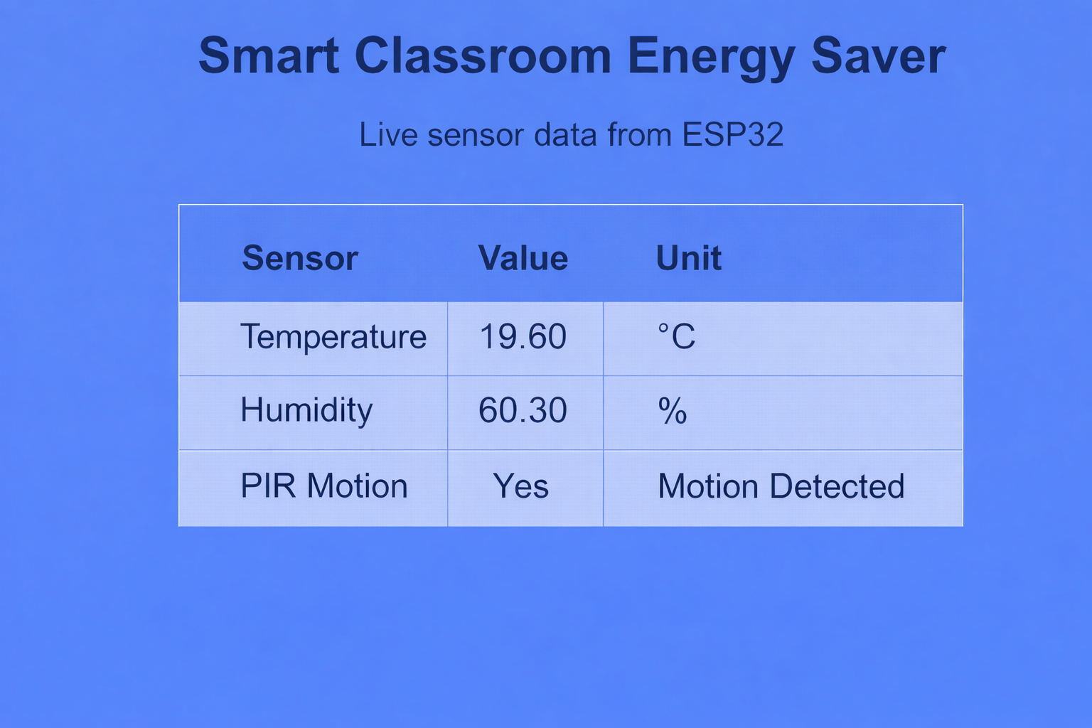

















Smart Classroom energy Saver
Paraic Gavin – 2nd Year Project
B.Eng(H) in Software & Electronic Engineering
Project Description
Architectural Diagram
Results
The Smart Classroom Energy Saver is an IoT -based system designed to automatically manage classroom electrical appliances based on the occupancy of the room using an ESP32 microcontroller.
The system detects human presence through PIR motion sensors and controls electrical devices such as lights and fans through relay modules.
When a person enters the classroom, the system automatically switches on the devices, and when the room is vacant for a specific period, it powers them off. This automation ensures optimal energy usage without requiring manual intervention.
A
ESP32
Lights, Fans etc.
Motion
Light Temperature
1)
Notifications
Features
Skills and Technologies
Sustainability
The temperature sensor helps the system automatically respond to classroom conditions by controlling fans, improving comfort and saving energy.
The PIR motion sensor detects movement in the classroom, allowing the system to turn devices on only when people are present.
The relay module acts as a switch that lets the system turn lights and fans on or off automatically.
C/C++ Programming
Java/JavaScript
CSS
HTML
Arduino IDE
Hardware Build and Test
Serial Interfacing
By implementing this system, institutions can significantly lower their electricity bills and carbon footprint.
This project also promotes sustainable practices among students and staff by encouraging them to use less electricity.

